Slide 1
Kells
Session 6
19 May 2018

Slide 2
Wifi
KPRC Training – kprc2000

Slide 3
CoderDojo Session
Dojo updates
Motto Recap
Warm Up
Outline the Tasks/Challenges for the Session
Brainstorm
Get Coding
Show your Work

Slide 4
Dojo updates
What have coding have we learnt?
Basic Blocks
Controls
Variables
Scrolling Backgrounds
Gravity
What else have we learned?
Getting to know each other
Brainstorming!
Teamwork
How to have fun programming?
The LAST CoderDojo session for this season

Slide 5
Our Dojo Mottos
One rule, be cool
Ask 3 then me
If you made it, you can play it
Parents, pitch in

Slide 6
Other small rules….
No open drink containers
Watch the wires!

Slide 7
Warm Up
5-10 mins

Slide 8
Get Into Teams
5 mins

Slide 9
This Week Session Challenges
Scratchers:
Make a maze game with a wall-collision
We need:
A player sprite
A wall sprite
Anything else you want!

Slide 10
Brainstorm
5-10 mins

Slide 11
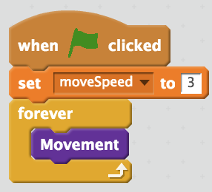
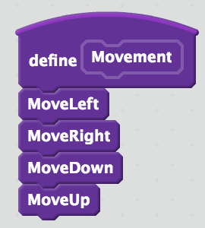
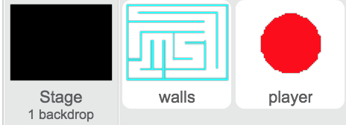
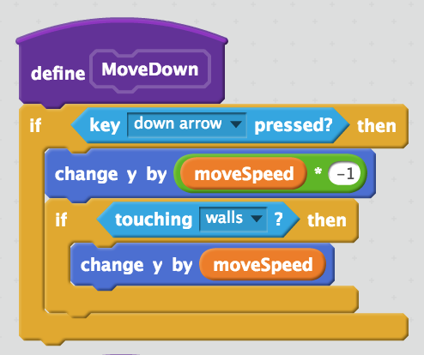

Get Coding
ALL SCRIPTS ON THE PLAYER SPRITE
3. We make a speed variable and define a new movement block!
4. We define other blocks that manage our controls!
45-60 mins
1. We need our player and wall objects - maybe color our background also?
2. It should look something like this
5. For each control, we set how it moves and undo movement when we touch a wall
6. Now define the rest of the controls

Slide 12
Showtime

